Slide 1
Accountability And Auditing
group members:
syed daniyal ali
syed muhammad ali farhan raza zaidi
syed hassan ali

Slide 2
Contents
Accountiblity
Pillar Of Accountability
Example Of Accountability
How Does It Help In Real Life
Auditing
Types of Auditing
Purpose Of Auditing
Pros/Cons Of Auditing

Slide 3
Accountability
Introduction
Accountability is the obligation of an organization or individual to account for activities and accept blame for failures. A person who is accountable may be called upon to answer and account for outcomes.

Slide 4
4 Pillars Of Accountability
Responsibility
A duty that Binds to the course of action
Answerability
Being Called to Account
Trustworthiness
A trait of being worthy of trust and confidence
Liability
Being legally bound to a debt or obligation

Slide 5
Example
customer service representative cancels a customer's account out of spite after they perceive the customer as being rude. The customer publicizes their experience. The customer service manager is called upon to account for the incident to executive management. In this case, the customer service manager is accountable for the incident and the customer service representative is responsible

Slide 6
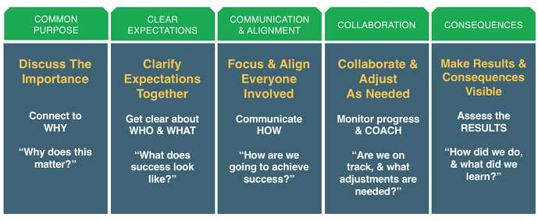
How Does IT Helps In Real Life

Slide 7
Auditing
Introduction:
The term audit usually refers to a financial statement audit. A financial audit is an objective examination and evaluation of the financial statements of an organization to make sure that the financial records are a fair and accurate.
Public companies are subject to provisions of the Securities Act of 1933 and the Securities
Exchange Act of 1934 that make an annual external audit a legal obligation
Auditing Can Be Done by Two Different Auditors.
Internal Auditor
External Auditor

Slide 8
Internal Auditing
Internal auditors work for the organization as internal employees to examine records and help improve internal processes such as
operations
internal controls
It will held on daily . Weekly or
monthly
It provide operational efficiency

Slide 9
External Auditing
External auditors come in from outside the organization to examine accounting and financial records and provide an independent opinion on these records.
The report generate by external audit is provided to stakeholders
It will held on Yearly
It provide accuracy and validity of financial Statement

Slide 10



Purpose Of Auditing
The Main Purpose Of Auditing Is
Detailed examination of the financial reports
of an organization.
Examination
Detection Of Errors In Financial Statement
Detection
Prevent Organization From Fraud like stealing
cash before or after it has been recorded
Prevention

Slide 11
Types Of Errors During Auditing
Error Of Principle
When the accounting principle are violated
Error of Clerical
Human Errors
Writing Error
Error Of Omission
Completely excluded
Partial excluded
Error OF Commission
Casting Error -> error during Sum
Posting Error -> post in different account
Recording Error -> Sales Transaction into Purchase
Error Of Duplication
Duplication Entry

Slide 12
Pros / Cons
Pros Of Auditing | Cons Of Auditing
Examine Financial Statement | Time Involved
Detection Of Fraud | Extra Cost
The Event Of Loss And Profit | Chances Of Fraud
Reports | Wrong Financials Statement
Control Fraud And Errors | Not Guranted

Slide 13
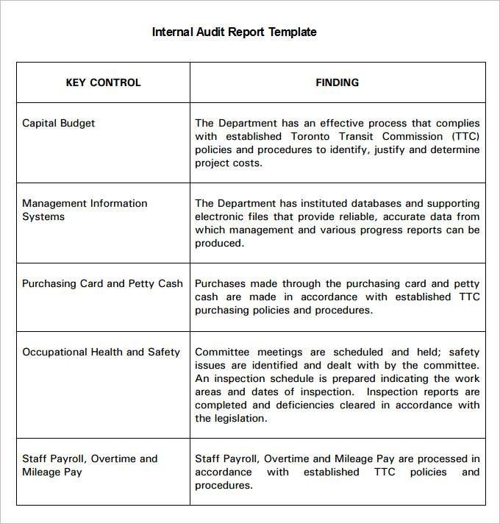
Sample Report Internal Auditing

Slide 14


